Slide 1
Graduate Student Association of Animal Scientists ANSC Graduate Student Orientation – August, 2021

Slide 2
GSA Mission
SOCIAL
EVENTS
Provide an
opportunity for
scientific interaction
between students
and faculty
Provide a forum
for exchange
of scientific
information
GENERAL
MEETINGS
Increase
intradepartmental
communication
PROFESSIONAL
DEVELOPMENT

Slide 3
GSA Membership
Currently enrolled graduate students whose major professor is a member of the faculty of the Department of Animal Sciences
all of you!
Requirements
None– just attend events!
Event notices will be communicated via email and Facebook

Slide 4
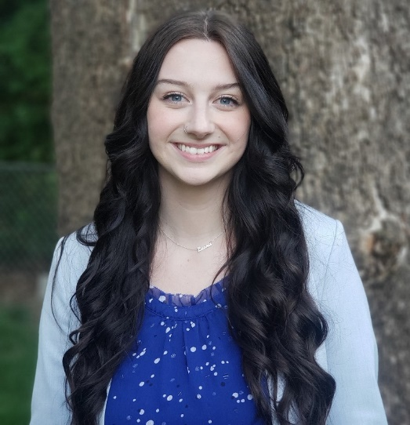
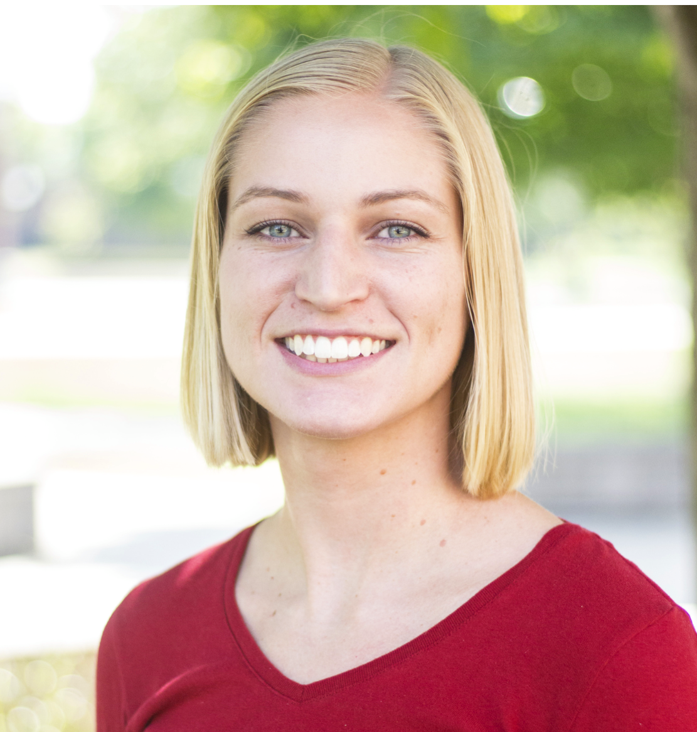
President and VP
Sara Tondini| President
Lab: Dr. Josh McCann
Research focus: Ruminant Nutrition and Microbiology
Species of Interest: Beef Cattle
stondin2@Illinois.edu
Juli Jespersen| Vice President
Lab: Dr. Ryan Dilger
Research focus: Coccidiosis and nutritional
interventions in broilers
Species of Interest: Chickens
jcj3@Illinois.edu

Slide 5
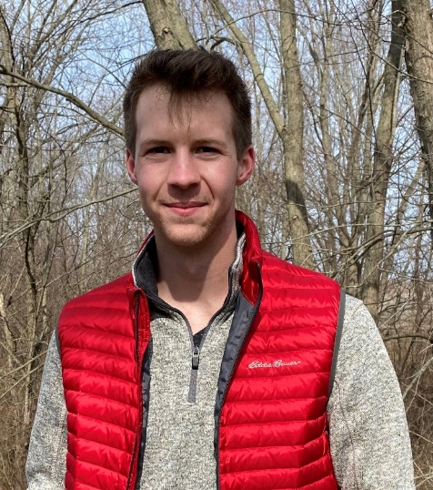
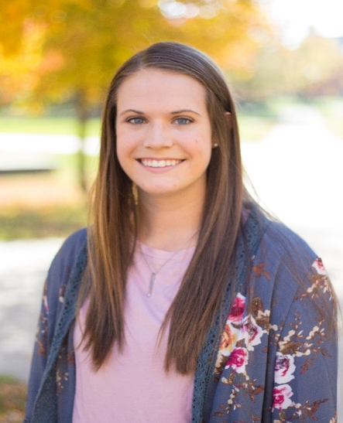
Treasurer and Secretary
Brad Gorenz | Treasurer
Lab: Dr. Ryan Dilger
Research focus: Poultry Nutrition
Species of Interest: Chickens
bgorenz2@Illinois.edu
Larissa Volz| Secretary
Lab: Dr. David Miller
Research focus: Reproduction
Species of Interest: Pigs
ljvolz2@Illinois.edu

Slide 6
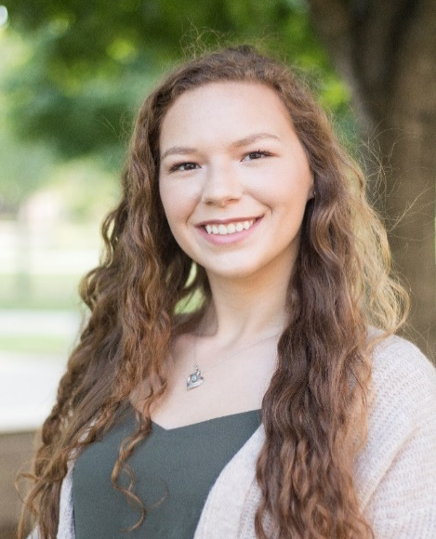
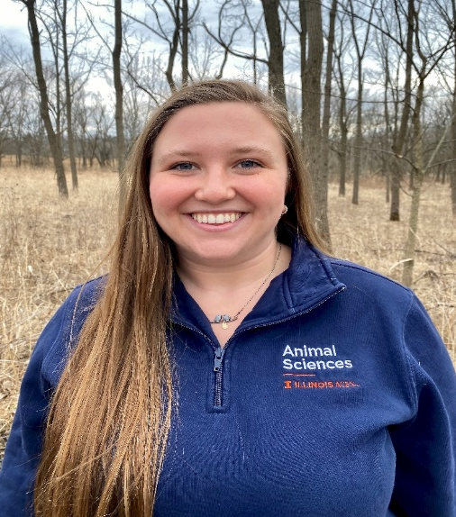
Social Co-Chairs
Kaitlyn Sommer
Lab: Dr. Ryan Dilger
Research focus: Swine Nutrition and Behavior
Species: Pre-wean piglets
ksommer3@Illinois.edu
Rebekah Drysdale
Lab: Dr. Carl Parsons
Research focus: Poultry Nutrition
Species: Chickens
rld2@Illinois.edu

Slide 7
GSA this Semester
We hope to be back in person!
GEO Informational Meeting
WHEN: August 31st 5:30-6:30 PM
WHERE: ASL 296
Welcome Back Social
WHEN: August 20th 8:30 PM
WHERE: Blind Pig Brewery on Neil St.
Upcoming events:
Fall Bake Sale
GSA Apparel

Slide 8
How to get information
1. Emails to ANSCI grad student listserv
2. Flyers on our bulletin board in North hallway of ASL
4. Website: https://publish.illinois.edu/anscgrad-gsa/

Slide 9
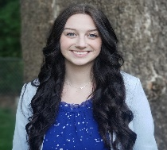
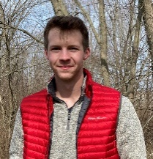
Questions?
Elections for officer positions for 2022 will be held this December!
Sara Tondini| President
stondin2@Illinois.edu
Brad Gorenz| Treasurer
bgorenz2@Illinois.edu
Juli Jespersen | Vice President
jcj3@Illinois.edu
Kaitlyn Sommer | Social Co-Chair
ksommer3@Illinois.edu
Larissa Volz | Secretary
ljvolz2@illinois.edu
Rebekah Drysdale| Social Co-Chair
rld2@Illinois.edu

